Slide 1
Infant and Young Child Feeding (IYCF) Financial Planning Tool
User’s Experience: Philippines
VICENTA E. BORJA, RN, MPH
Supervising Health Program Officer and Program Manager, IYCF
Department of Health
Philippines

Slide 2
Part I
Philippine IYCF Strategic Plan of Action 2011-2016

Slide 3
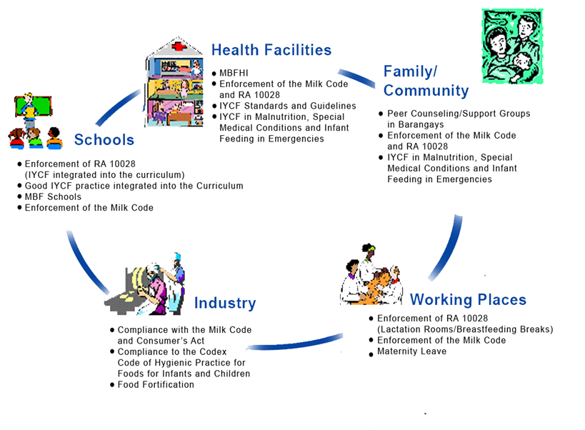
Key Intervention Settings and Services

Slide 4
Framework: National Plan of Action for Infant and Young Child Feeding, Philippines, 2011-2016
Strategies
Partnerships with NGOs and GOs in the coordination and implementation of the IYCF program
Integration of key IYCF action points in the MNCHN Plan of Action
Harnessing the executive arm of government to implement and enforce the IYCF related legislations and regulations (EO 51, RA 7200 and RA 10028)
Intensified focused activities to create an environment supportive to IYCF practices
Engaging Private Sector and International Organization to raise funding for the scaling up and support of the IYCF program
Action Points
1.1 Formalize partnerships with GOs and NGOs working on IYCF program coordination and implementation
2.1 Institutionalize the IYCF monitoring and tracking system for national, regional and LGU levels
2.2 Participation of the IYCF Focal person in MNCHN planning and monitoring activities
3.1 Consultation mechanism with the IAC and DOJ for the enforcement of the Milk Code and with other relevant GOs for other IYCF related legislations and regulations
3.2 Support Civil Society in the implementation and enforcement of IYCF related laws and regulations
4.1 Modeling the MBF system in the key intervention settings in selected regions
4.2 Creation of a Regional and National incentive and awarding systems for the most outstanding IYCF champions in the different sectors of society
4.3 Allocate/Raise /Seek resources for IYCF Research activities that document best practices in the Philippines
5.1 Setting up of a fund raising mechanism for IYCF with the participation of International Organizations and the Private Sector
Intervention Focus
Health Facility
(all levels )
Family/Community/Public Place
Workplace
(formal and informal)
School
(different levels)
Industry
(monitoring & compliance)
Goal
Reduction of child mortality and morbidity through optimal feeding of infants and young children
Capacity Building
Supportive Supervision
Communication

Slide 5
PART II
Experience…

Slide 6
Part III. General Observations
Strengths:
User friendly
just need initial assistance for a person who wants readily available form
Efficient
provides the components essential for funding IYCF
implementation and prioritizing activities
Encouraging
gives an overall idea of the budget needed for IYCF without using calculator repeatedly
Notes:
Even if you are not that knowledgeable in the use of computer, initial assistance by a more experienced person can facilitate and encourage the use of the tool.

Slide 7
General Observations
Weaknesses:
Sometimes disturbing/ challenging
- an “alien” (runtime error “1004” appears whenever I need to “save” my work;
- when a work that is not yet completed is saved and left, when returning back to continue, the cursor is not in the same subject;
- need to scroll back and forth to see the headings of the items when typing cost as the whole page is not visible in the screen (ex. training under health & nutrition)
Notes:
Something went wrong on the tool for the maternity protection? It’s the system I think that has problem with it…

Slide 8
Recommendation:
minor improvement in the system to be more user-friendly;
Endorse the tool to support efficient planning for IYCF (National, Regional, District/Provincial/Local);
Be open to other components that may be added by countries based on felt needs;
Conduct follow-up of countries who adopted the IYCF Financial Planning Tool ;
Notes:
Resolve the weaknesses I observed when using the tool…But this can be endorsed already with minor improvement in the system…

Slide 9
Lastly…
Congratulations to IBFAN Asia for this another worthy endeavor to support IYCF and to Mr. Alessandro Iellamo, IBFAN Asia Consultant who did the hard work of making this IYCF Financial Tool a reality.

Slide 10
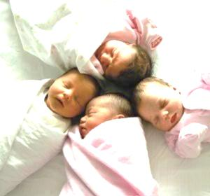
THANK YOU!!!

