Slide 1
Investing in the Breastfeeding Movement in India
Breastfeeding Promotion Network of India
2016

Slide 2
CRITICAL ISSUES
Dealing with promotional tactics of baby food industry
Dealing with conflicts of interest issues in nutrition policy, programmes and BINGOs
Addressing lack of information to women and community
Addressing increased Non-Communicable Disease (NCD) Burden with focus on childhood obesity and diabetes
Mobilizing global and countywide support to track breastfeeding trends
Improving breastfeeding rates
Addressing unstable funding situation

Slide 3
PURPOSE
To assist and support the Centre and State Governments in India for implementing the IMS Act; to contribute to bridging gaps in programmes on promotion and support of breastfeeding; to monitor the Global Strategy for Infant and Young Child Feeding globally and nationally using innovative tracking tools; to monitor the nutrition and food businesses to keep a check on unethical/inappropriate marketing and promotion of baby foods, other unhealthy foods, related equipment; and to reach out to women with accurate information in order to improve health and nutrition of women and children.

Slide 4
RESULT FRAMEWORK
RESULT 1
RESULT 2
Strengthened capacity of the governments both at the centre and state in implementing the IMS Act
Strengthened capacity of State governments to implement skilled breastfeeding and infant and young child feeding counseling especially for the recently launched MAA programs.

Slide 5
RESULT FRAMEWORK
RESULT 3
RESULT4
Innovative tools used to mobilise 50 to 70 countries and 10 States of India for policy assessment and policy environment at national level strengthened.
Alerts are created and disseminated on inappropriate marketing of unhealthy foods and strategic alliances with civil society organizations developed

Slide 6
RESULT FRAMEWORK
RESULT 5
RESULT 6
Simple and correct information made available to the public through BPNI's book, 'Breastfeeding and Complementary Feeding - A Guide for Parents'
Guidelines on Conflicts of Interest developed and Alerts on COI issued

Slide 7
RESULT 7
Sustainability of
fund achieved
through multiple
approaches of
fundraising

Slide 8
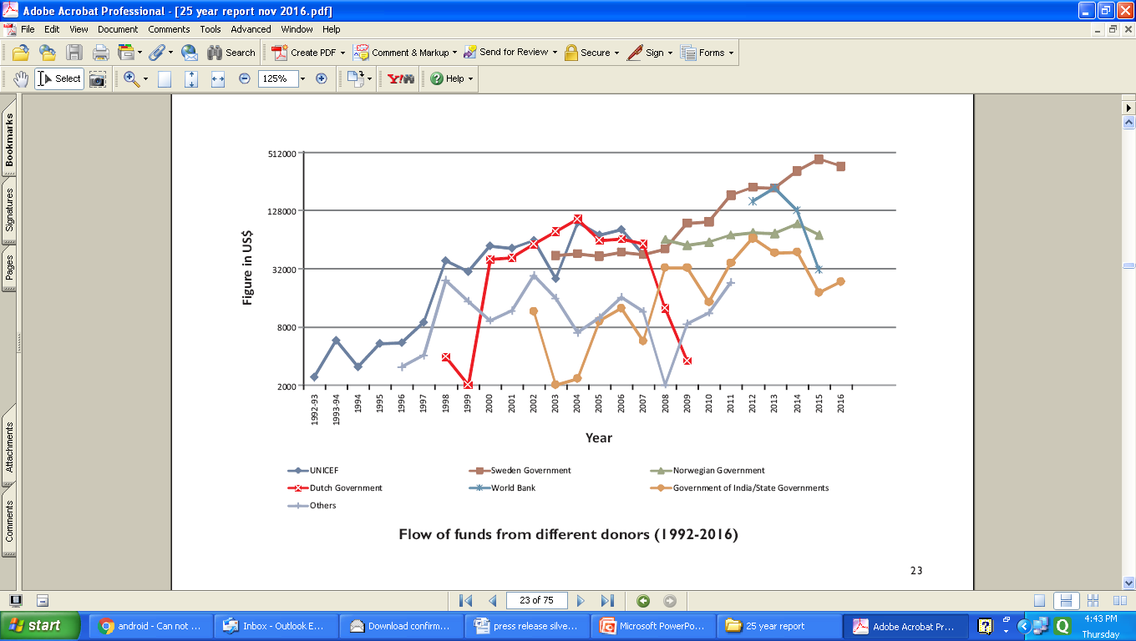
Flow of funds from different donors(1992-2016)

Slide 9
Way Forward
Invite partnerships with governments and other development partners in these areas

